Slide 1
Automated Class Assist
Team Number:8
Students:
1.Hafiz shefeekh TOC20RA022
2.Musharraf Hussain TOC20RA037
3.Sanjo Shaji TOC20RA042
4.Shrijit V TOC20RA043
Project Guide: Asst Prof. Rekha George

Slide 2
Abstract
An Automated mobile robot is a type of robot that can understand and move through its environment independently.
AMR use a set of sensors, for obstacle avoidance, path planning to interpret and navigate through their environment
The goal of the project is to develop a mobile robot capable of transferring files and documents to various classes in a floor by line following mechanism and obstacle avoidance method

Slide 3
Introduction
Automated wheeled robot that navigate through floor and
safe transfer of files and attendance sheet collection in classes
An Automated Guided Vehicle (AGV), is a portable robot that follows along marked long lines or wires on the floor, or uses radio waves, vision cameras, magnets, or lasers for navigation.
This reduces human involvement and time consumption in a complex College environment.

Slide 4
Literature Survey
S. No. | Title of the Paper | Names of the Authors | Name of Journal / Conference Proceedings | Year | Methodology | Merits | Drawbacks
1 | Design and Modelling of Autonomous Mobile Robot for Material Handling | S.Madhankumar, P. Anandraj, Anirudh Varadarajan, R. Aravind Kumar, K. Kaleeswaran | International Conference on Advanced Computing and Communication Systems | 2021 | Ultrasonic and photoelectric sensors, use for path mapping process | Low cost ,less complex | Inaccurate in measuring, short range
2 | Microcontroller-based mobile robot positioning and obstacle avoidance | Aziza M.Zaki, Osama Arafa, Sanaa I. Amer | Journal of Electrical Systems and Information Technology | 2014 | Navigation system built on combines the perception and dead reckoning. Ultrasonic transducers give 3D view. | Determine one’s own position, and the ability to reach certain goal locations. | Complex algorithm and high computational time
4

Slide 5
Literature Survey
S. No. | Title of the Paper | Names of the Authors | Name of Journal / Conference Proceedings | Year | Methodology | Merits | Drawbacks
3 | Obstacle detection using ultrasonic sensor for a mobile robot | Joseph Azeta, Christian Bolu , Daniel Hinvi and Abiodun A. Abioye | International Conference on Mechatronics and Control Engineering | 2019 | Selection of ultrasonic sensors, and the algorithms for path mapping process | Extremely low-cost , large field of detection. | Limited testing distance, inaccurate readings, and inflexible scanning methods
4 | Obstacles Avoidance for Mobile Robot Using Type-2 Fuzzy Logic Controller | Mohammad Al-Mallah , Mohammad Ali and Mustafa Al-Khawaldeh | MDPI Robots Journal | 2022 | Adapting solutions to real-world surroundings with fuzzy logic controller; wireless sensor network | No precise inputs are required, | Requiring precise knowledge about environment and long computational times

Slide 6
Literature Survey
S. No. | Title of the Paper | Names of the Authors | Name of Journal / Conference Proceedings | Year | Methodology | Merits | Drawbacks
5 | Mobile Robot Navigation and Obstacle Avoidance Techniques: A Review | A Pandey, S Pandey, DR Parhi | International Robotics & Automation Journal | 2017 | Artificial Neural Network, Fuzzy Logic based localization | High accuracy in detecting the environment | Limited by the battery life and high computational required

Slide 7
Details of study of existing systems
Food delivery robots are used to deliver food from restaurants to households
Eg:Sidewalk robot by starship tech,amazon scout
Medical robots are used to transfer medical equipment inside the hospitals
Eg: The tug by Aethon Inc
Automatic trolleys are also used in factories.
Eg: Sterela robotics automatic trolley

Slide 8
Objectives of the Project
To design a line following AGV using IR sensors.
To develop an obstacle avoidance system using ultra-sonic sensor.
To build an automated class assist robot for transporting files and documents
To fabricate a robot integrating all the above features.

Slide 9
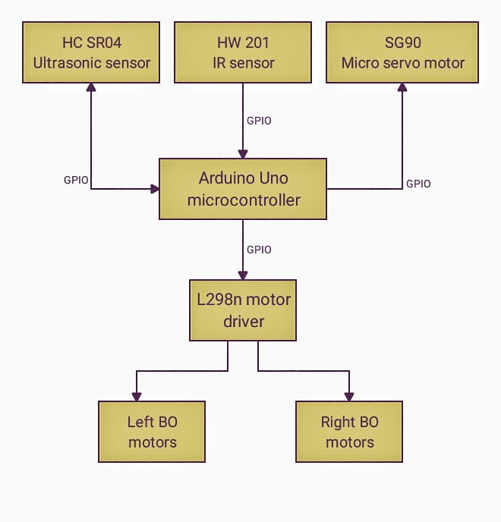
Hardware Design

Slide 10
Component Description
Arduino Uno ATmega328P
Ultrasonic sensor
IR Sensor
Motor driver
DC Motors
Li-Po Battery

Slide 11
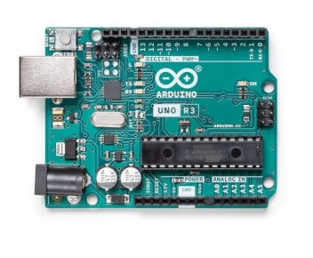
Arduino UNO ATmega328P
ATmega328P with1kb of EEPROM
14 digital input/output pins (of which 6 can be used as PWM outputs), 6 analog inputs
16 MHz ceramic resonator
an 8-bit microcontroller with 32KB of Flash memory and 2KB of RAM

Slide 12
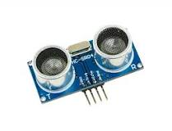
The HC-SR04 Ultrasonic Range Sensor Features
Input Voltage: 5V.
Current Draw: 20mA (Max)
Digital Output: 0 to 5V.
Working Temperature: -15°C to 70°C.
Frequeny range of 30–500 kHz
Sensing range : 2 to 400 cm

Slide 13
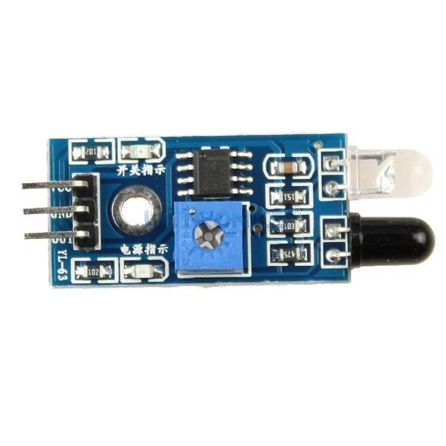
IR INFRARED
5VDC Operating voltage
I/O pins are 5V and 3.3V compliant
Range: Up to 30cm
Adjustable Sensing range
Built-in Ambient Light Sensor
20mA supply current
Mounting hole

Slide 14
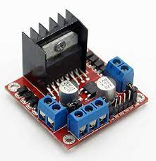
L298N Motor Driver Module
Driver Model: L298N 2A
Driver Chip: Double H Bridge L298N
Motor Supply Voltage (Maximum): 46V
Motor Supply Current (Maximum): 2A
Logic Voltage: 5V
Driver Voltage: 5-35V
Driver Current:2A
Logical Current:0-36mA
Heatsink for better performance
Power-On LED indicator

Slide 15
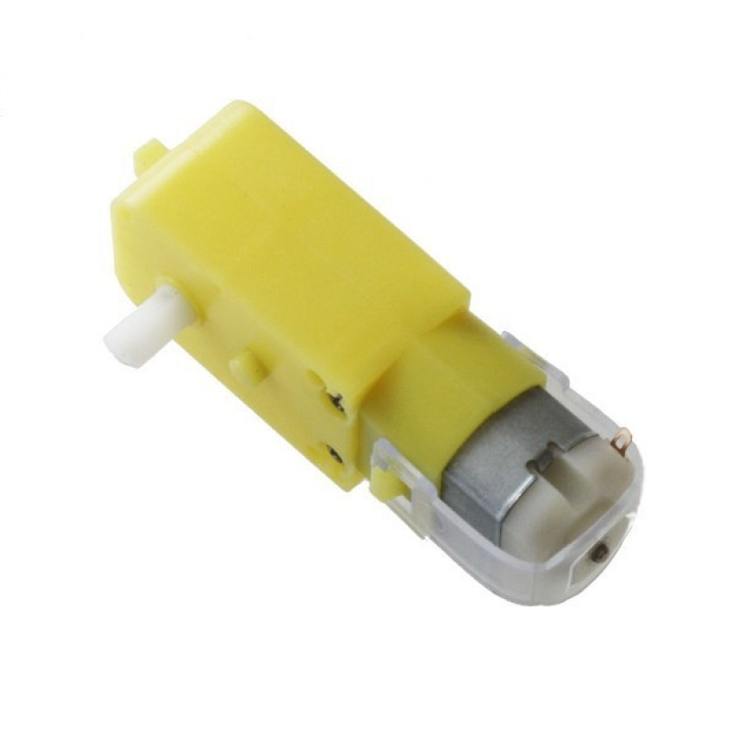
DC Motor
Elimination of machining operations.
Low density: lightweight, low inertia.
Operating Voltage: 3 to 12V.
Current (without loading): 40-180mA.
RPM: 150 rpm.
Output Torque: 0.8 kg cm.

Slide 16
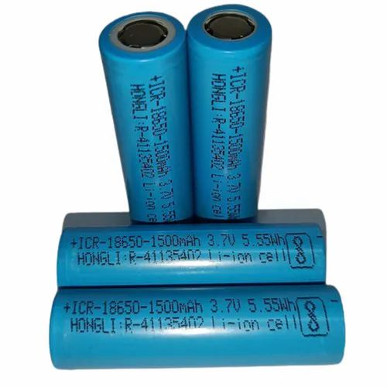
Li-Po Battery
High Capacity and Stable Discharge Voltage
Light Weight, Small Size and High Performance
Small Internal Resistance
Outstanding Discharge Properties and Storage Capacity
Pollution free, Long Cycle Life
Battery capacity: 1200mAh
Power: 3.7V

Slide 17
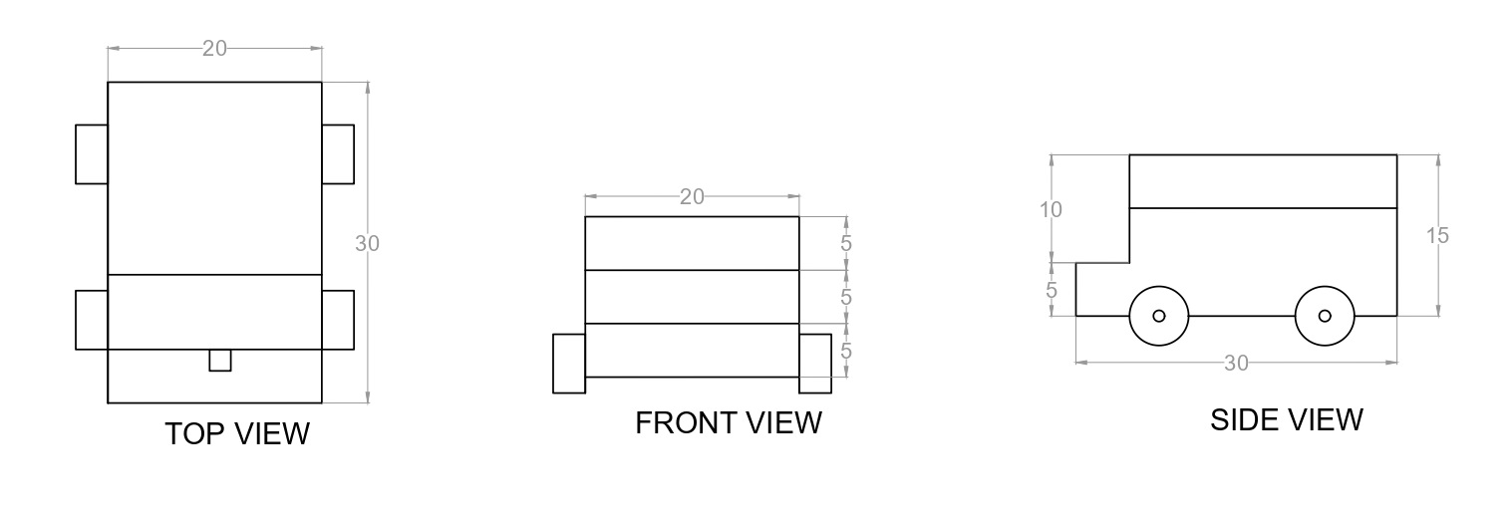
Mechanical Design (Units in cm)

Slide 18
Software Requirements
Programming software- Arduino IDE
Designing software- Autocad
Programming Language- C

Slide 19
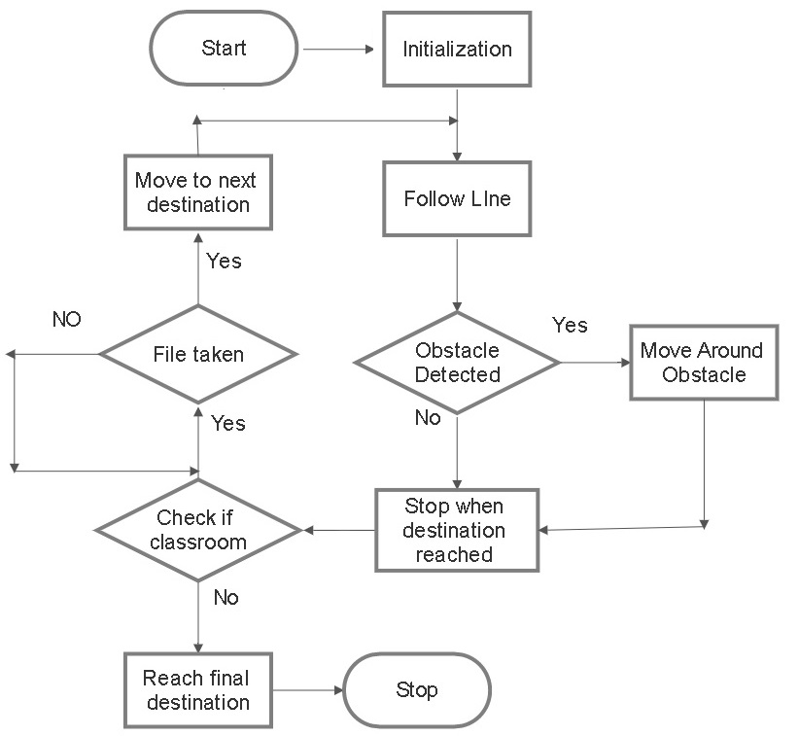
Flowchart/Algorithm

Slide 20
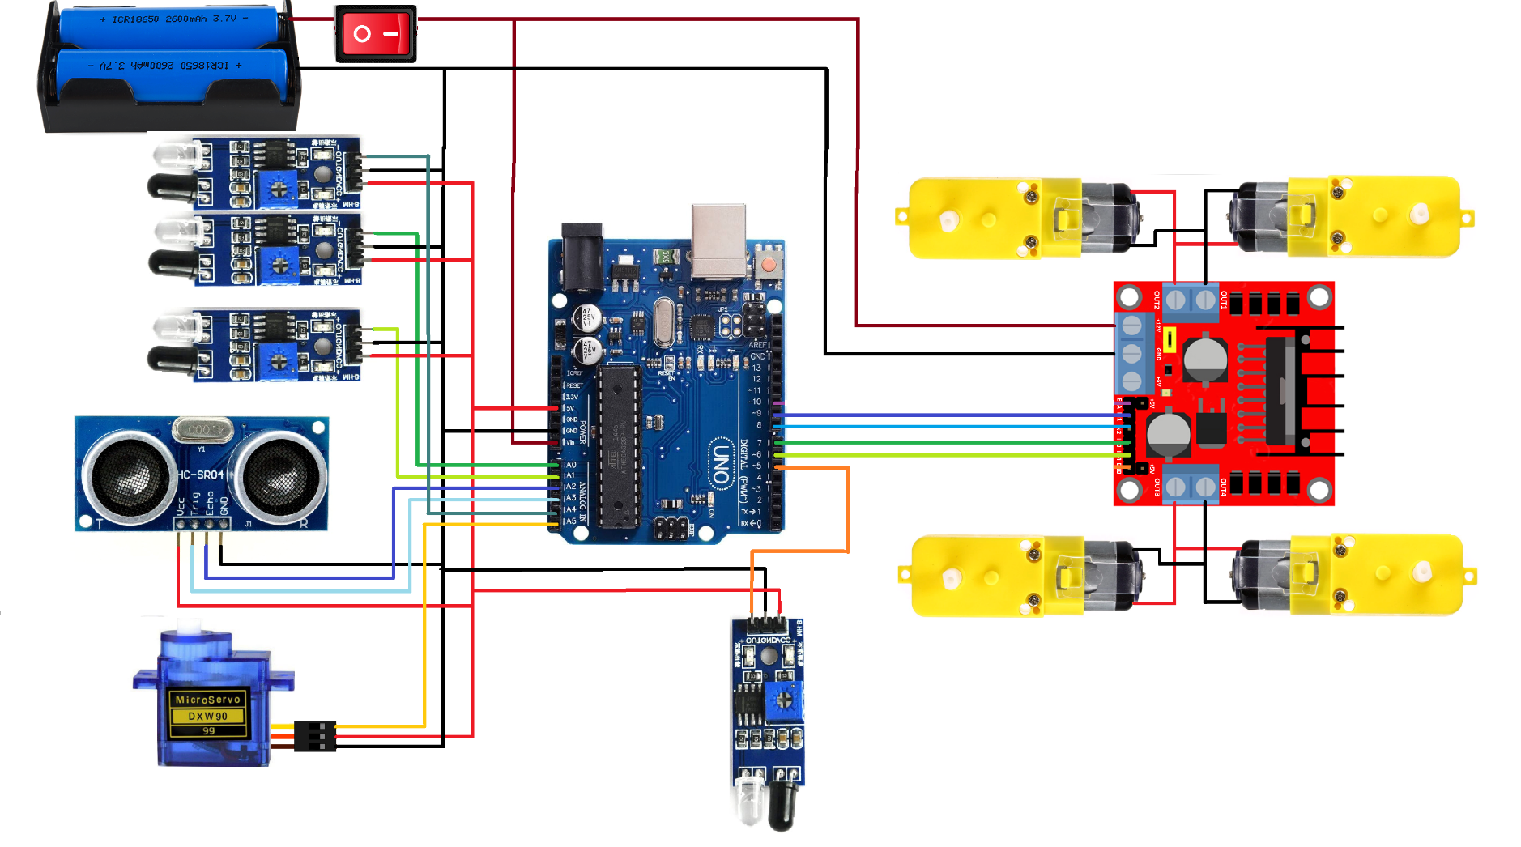
Circuit Diagram

Slide 21
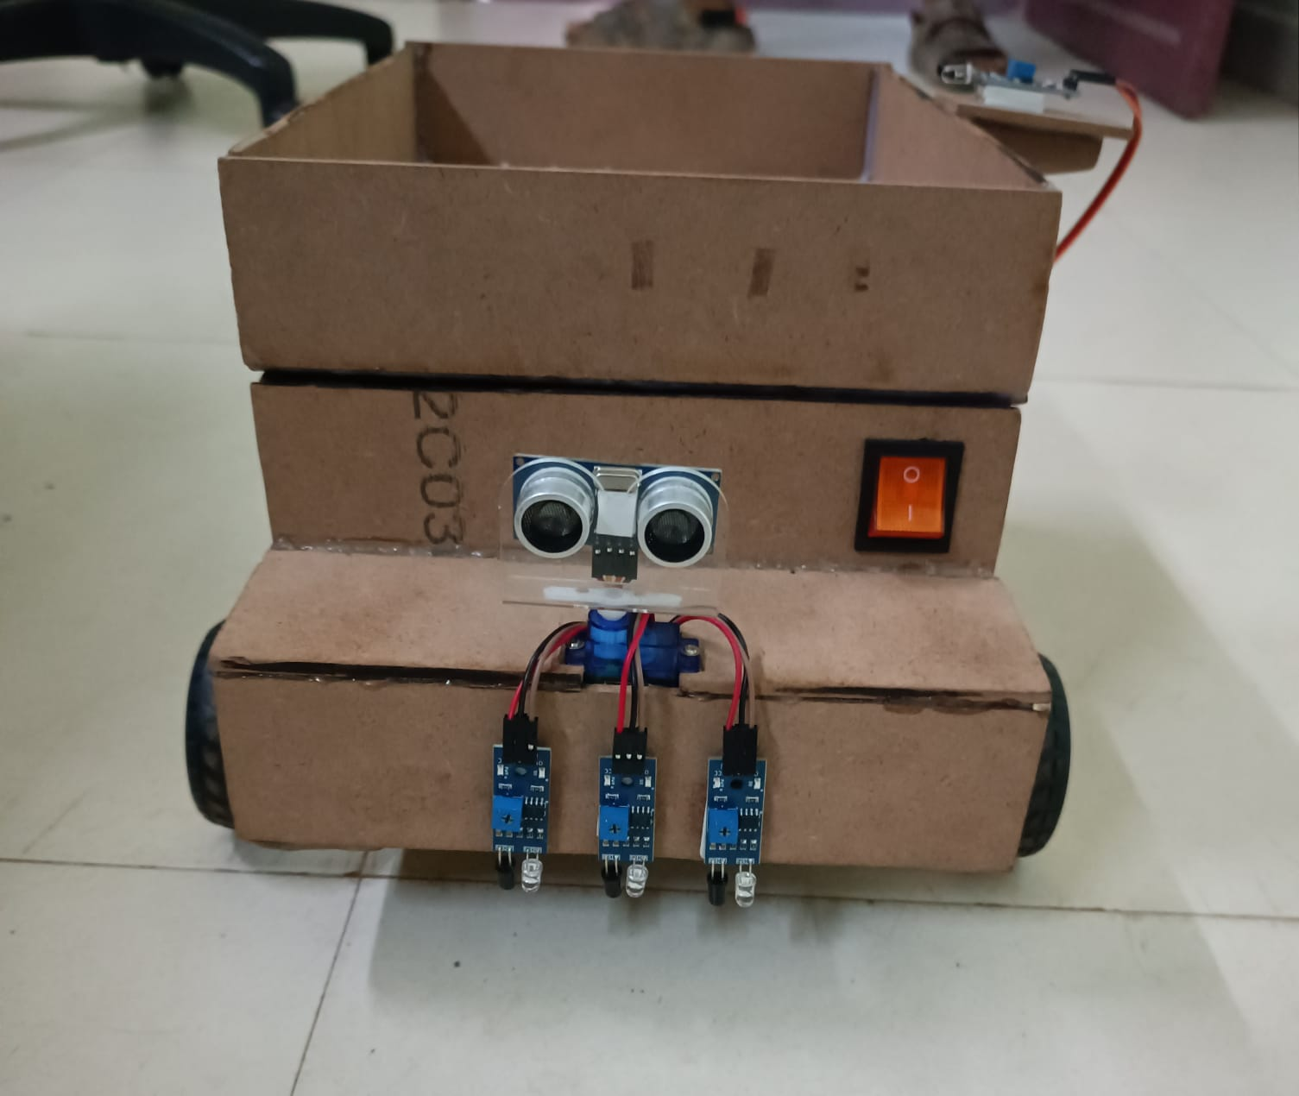
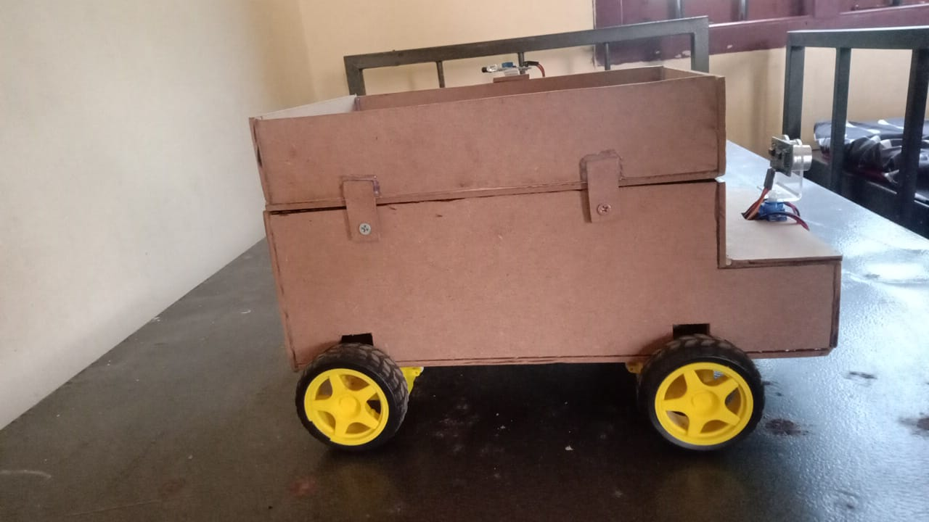
Results

Slide 22
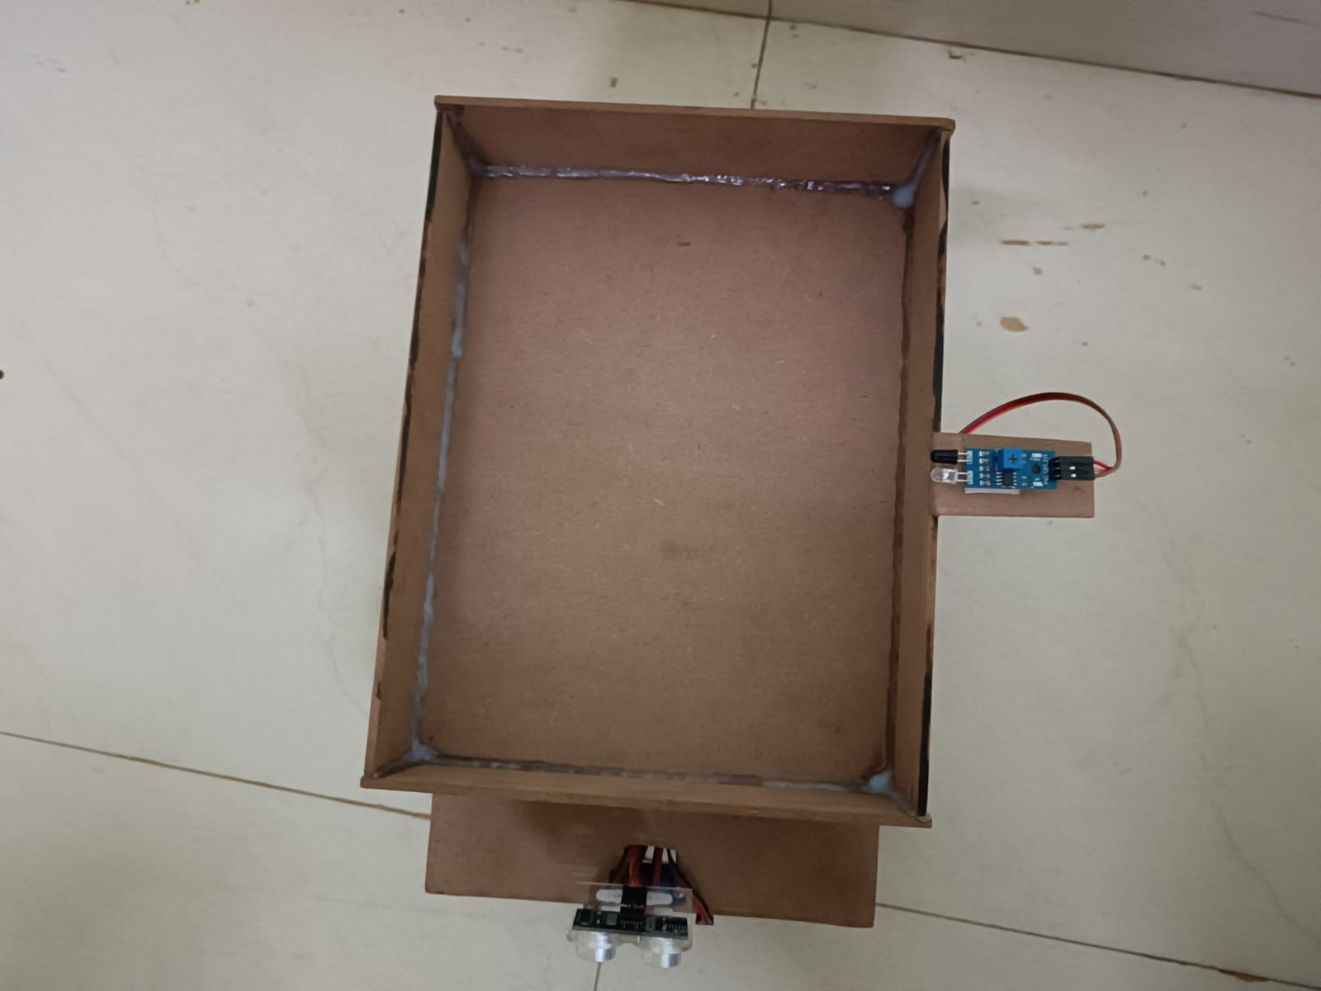
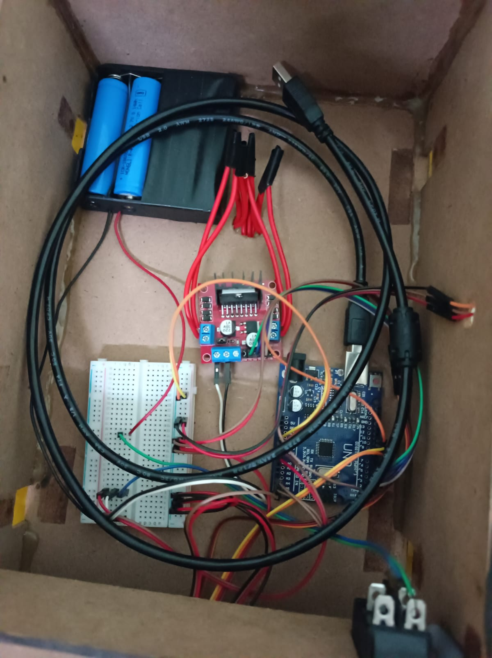
Results

Slide 23
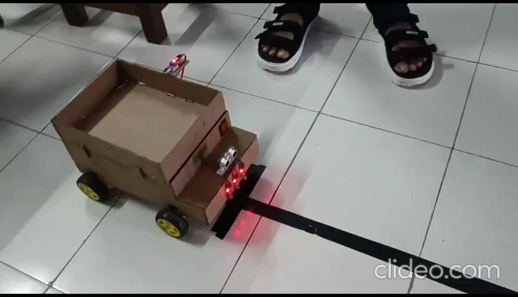
Results

Slide 24
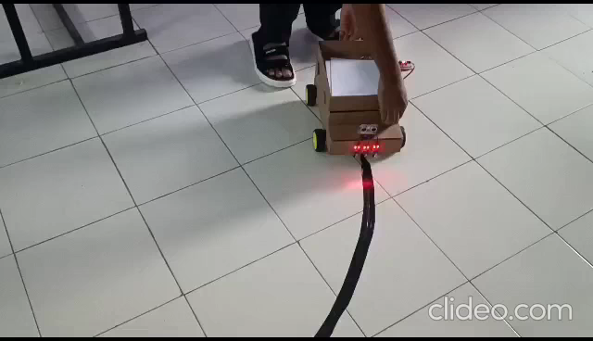
Results

Slide 25
Conclusion
The prototype of the system developed here can share file among a few classroom and staffroom.
Use of this robot in college make the college environment more efficient , working friendly and faster.
This system is applicable for carrying documents or goods within the places at the same floor.
The results demonstrate the successful implementation of the file line-delivering robot using the Arduino Uno microcontroller.

Slide 26
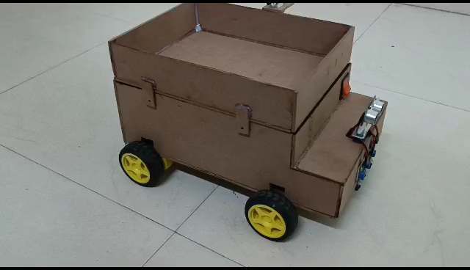
Conclusion

Slide 27
Future Work
In future the system can be developed to do the same task within the places of several floor and may be it can be develop to do the file transfers throughout the college campus from department to another department
RFID Readers can be used to deliver things to specific classes
Mobile app can be used to call the robot to required class and it can be scheduled to perform routine tasks
A Self charging mechanism can also be included

Slide 28
Timeline of the Project
S. No. | Work Planned | Date of Completion
1 | Introduction to Miniproject | 9/2/2023 to 17/2/2023
2 | Designing of the framework , collecting components | 27/2/2023 to 10/3/2023
3 | Build the body of the robot | 13/3/2023 to 25/3/2023
4 | Design the circuit diagram and flowchart | 27/3/2023 to 12/4/2023
5 | Implementation of line following and Obstacle avoidance | 13/4/2023 to 26/4/2023
6 | Completion of project | 01/06/2023 to 09/06/2023

Slide 29
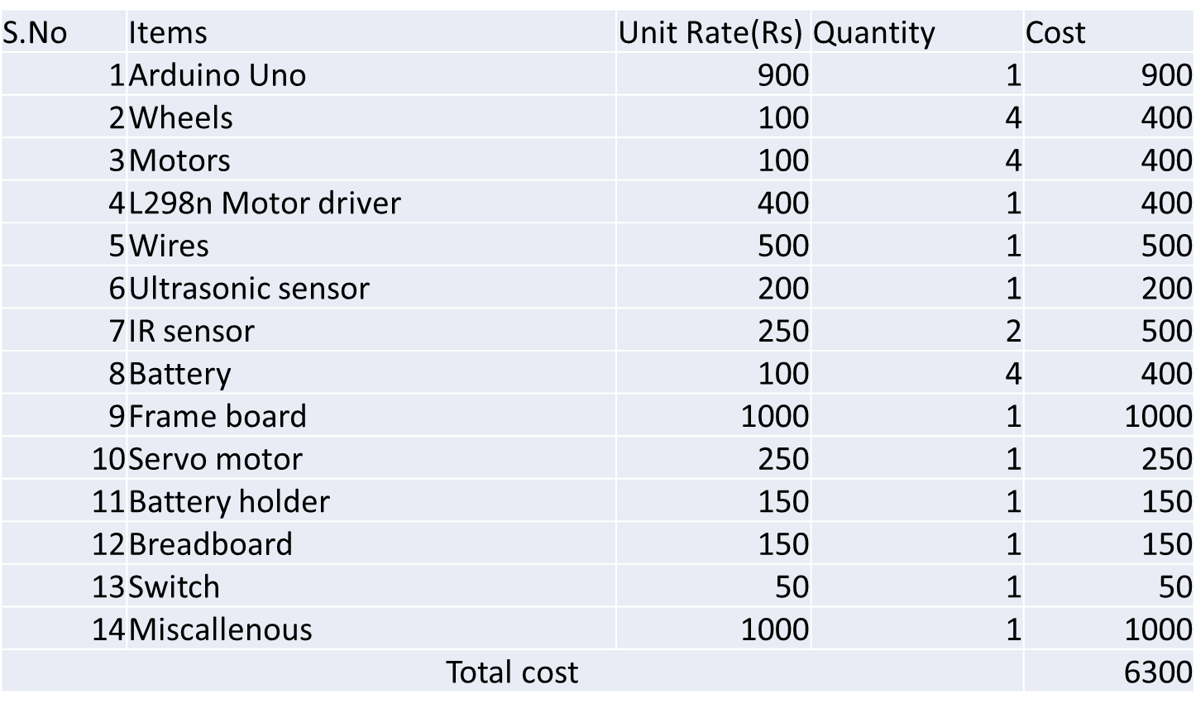
Budget

Slide 30
References
[1].Madhankumar, S., Anandraj, P., Varadarajan, A., Kumar, R.A. and Kaleeswaran, K., 2021, March. Design and Modelling of Autonomous Mobile Robot for Material Handling. In 2021 7th International Conference on Advanced Computing and Communication Systems (ICACCS) (Vol. 1, pp. 738-742). IEEE.
[2].Zaki, A.M., Arafa, O. and Amer, S.I., 2014. Microcontroller-based mobile robot positioning and obstacle avoidance. Journal of Electrical Systems and Information Technology, 1(1), pp.58-71.
[3].Azeta, J., Bolu, C., Hinvi, D. and Abioye, A.A., 2019, November. Obstacle detection using ultrasonic sensor for a mobile robot. In IOP Conference Series: Materials Science and Engineering (Vol. 707, No. 1, p. 012012). IOP Publishing.
[4].Al-Mallah, M., Ali, M. and Al-Khawaldeh, M., 2022. Obstacles Avoidance for Mobile Robot Using Type-2 Fuzzy Logic Controller. Robotics, 11(6), p.130.
[5].Pandey, A., Pandey, S. and Parhi, D.R., 2017. Mobile robot navigation and obstacle avoidance techniques: A review. Int Rob Auto J, 2(3), p.00022.

Slide 31
THANK YOU

